Slide 1

KERVYN
From production data
to quality intelligence
AI-powered PCBA manufacturing quality intelligence
Turn fragmented production events into actionable quality intelligence.
ExaThon India 2026 • Factories, Fleets & Supply Chains

Slide 2
Quality problems hide between production stages
A board moves continuously. Its evidence often does not.
Incoming
materials
SMT placement
Reflow + AOI
Test + repair
Final quality
Machine logs
Repair notes
Inspection results
Lot context

Slide 3
The missing layer is connected quality intelligence
Reports can describe events. The missing layer links context across stages, boards and defects so teams can interrogate the journey.
CONNECTED
QUALITY INTELLIGENCE
Spreadsheets
Machine reports
Static dashboards

Slide 4
Meet Kervyn: one view of the PCBA quality journey
A focused intelligence layer for monitoring production, analyzing quality and asking grounded questions.
01
02
03
Production monitoring
Quality analytics
Conversational AI
Follow boards, batches and stage events.
Explore defects, trends and detailed records.
Ask questions and render charts or tables.

Slide 5
From board to insight: a connected data model
The implemented KERVYN schema connects ten entities around traceability, process evidence and quality outcomes.
batches
stages
products
boards
machines
10 TABLES
ONE QUALITY JOURNEY
inspections
operators
defects
events
repairs

Slide 6
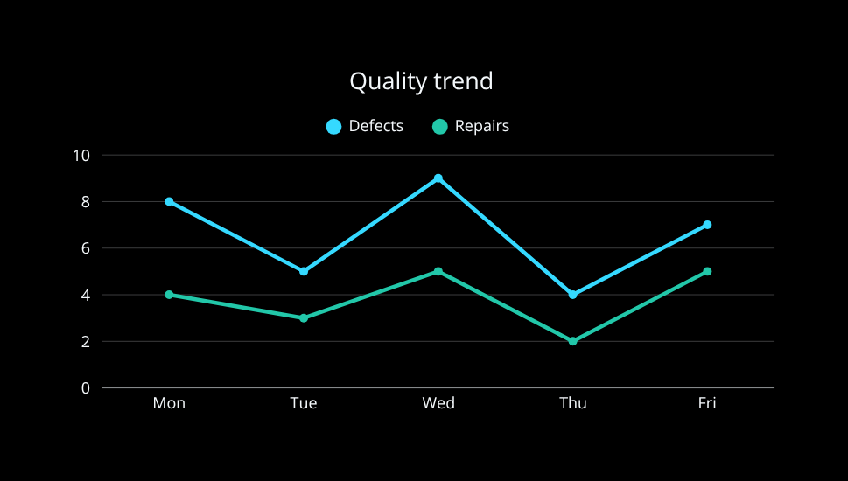
A live operational view of quality
Implemented datasheet experience: filter the journey, inspect records and export evidence.
Boards
1,248
Pass rate
97.4%
Defects
33
Repairs
19
Stage filter: AOI
Defect: solder bridge
Board: PCB-10482
Export: JSON

Slide 7
Ask manufacturing questions in plain language
Kervyn AI turns a question into a grounded analytical response, with the result rendered in the form that fits.
Which defect category increased after reflow this week?
Solder-bridge events increased in the selected period. The response cites the filtered records and can be viewed as a table or chart.
CHART
TABLE

Slide 8
The AI is constrained by an engineering pipeline
Grounding is not a prompt trick. Each question passes through an explicit path before an answer reaches the interface.
User
question
Intent +
schema context
SQL
generation
Validation +
execution
Structured
result
Answer +
visualization
Natural language → bounded analytical query → database-grounded response

Slide 9
Safety and control are built into the query path
These controls apply to AI analytical queries—not to every API route.
Schema allowlist
Only known analytical entities
Read-only intent
No mutation through AI queries
Query validation
Reject unsupported structures
Execution limits
Bound result size and runtime
Grounded output
Answer from returned records
Clear scope
AI path ≠ whole API surface

Slide 10
Built, connected and demonstrable
Repository-backed implementation across interface, API, database and AI integration—with a seeded schema and a practical deployment pathway.
React / Vite
UI
Express
API
Exasol
SQL engine
Sarvam
integration
Seeded
10-table schema
Local → cloud
pathway
IMPLEMENTED PROTOTYPE • DEMO-READY FLOW

Slide 11
Value to a manufacturing team
Pilot hypotheses—not measured outcomes. The objective is to test whether connected context improves speed, confidence and actionability.
Faster investigation
Earlier pattern visibility
Can teams trace a defect across stages with fewer handoffs?
Can recurring signals surface before review meetings?
Shared quality context
Lower reporting friction
Can production and quality work from the same evidence?
Can common analytical questions require less manual assembly?

Slide 12
A practical path from prototype to factory pilot
Separate what works today from the next engineering steps required for a production environment.
NOW
CONNECT
VALIDATE
HARDEN
Seeded schema
Datasheet + AI flow
Machine adapters
Identity + access
Pilot workflows
Ground-truth review
Observability
Scale + governance

Slide 13

Kervyn makes quality data easier to act on.
Our ask
An opportunity to validate Kervyn in a PCBA manufacturing pilot—and feedback from ExaThon judges on real production workflows.
LET’S VALIDATE ON THE FACTORY FLOOR

